Slide 1
Time Complexity

Slide 2
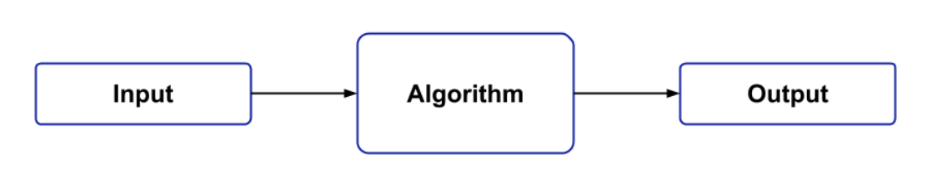
Basics:
Correctness
Finiteness
Efficiency

Slide 3
Algorithm Efficiency
Time Complexity
The time complexity is the number of operations an algorithm performs to complete its task with respect to input size
Space Complexity
Space Complexity of an algorithm denotes the total space used or needed by the algorithm for its working, for various input sizes

Slide 4
ASYmptotic Notations
Asymptotic notations are the mathematical notations used to describe the running time of an algorithm when the input tends towards a particular value or a limiting value.
The study of change in performance of the algorithm with the change in the order of the input size is defined as asymptotic analysis.
There are mainly three asymptotic notations: Theta notation, Omega notation and Big-O notation.

Slide 5
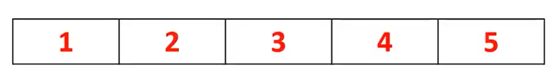
Asymptotic notations
Best Case: Big Omega (Ω)
Average Case:Big Theta(Θ)
Worst Case:Big O(O)

Slide 6
time complexity:O(1)
int input1 = 10,
input2= 20,
sum;
sum = input1 + input2;
O(1)
int orderOfOne(int n)
{
int result = n * n;
return result;
}
O(1)
O(1)
O(1)
O(1)+O(1)+O(1)=O(3)
TimeComplexity:O(1)
Note:Constants to be eleminated
Since 3 is Constant, eliminate it
Constant Time

Slide 7
time complexities:O(n)
public void OrderOfN(int n)
{
for(int i=1;i<=n;i++)
{
Console.WriteLine(i);
}
}
When:
n= 5 , loop executes 5 times O(5)
n=10, loop executes 10 times O(10)
Time taken to execute the depends on n
Time Complexity:O(n)
int orderOfn(int n,int[] arr)
{
for(int i=0;i<n;i++)
{
if(arr[i]==0)
{
return 0;
}
}
return 1;
}
Time Complexity:?
O(n)
Linear Time

Slide 8
time complexity:O(N²)
int result = 0;
for (int i = 1; i <= n; i++)
{
for(int j=1;j<=n;j++)
{
result += 1;
}
}
Consider ,n =4
When i=1 ,j executes = 4 times
When i=2 ,j executes = 4 times
When i=3 ,j executes = 4 times
When i=4 ,j executes = 4 times
result statement executes 4+4+4+4 times → 4² →O(n²)
Quadratic time

Slide 9
time complexity:O(N+M)
int OrderOfNplusM(int n,int m)
{
int result = 0;
for (int i = 1; i <=n; i++)
{
result += i;
}
for (int j = 1; j <= m; j++)
{
result += j;
}
return result;
}
Loop 1 executes n times
N=4 , 4 times
N=7,7 times
Loop 2 executes m times
M=10, 10 times
M=15, 15 times
Time Complexity:O(n+m)

Slide 10
time complexity:O(log n)
int OrderOflogn(int n)
{
int result = 0;
while (n>1)
{
n = n / 2;
result += 1;
}
return result;
}
Given : n=8
Iteration:1
While(4>1)
n=n/2 =4
Iteration:2
While(4>1)
n=4/2 =2
Iteration:3
While(4>1)
n=2/2 =1
Iteration:4
While(1>1)
Loop executes n/2 times →n=2^{x}
→ n=2³
Taking log on both sides
log n=log 2^{x} → log n=log 2³
log n =x log 2 → log n=3 log 2
Note :log 2 =1
log n=x →log n =3 →log n
Time Complexity:O(log n)
Logarithmic time

Slide 11
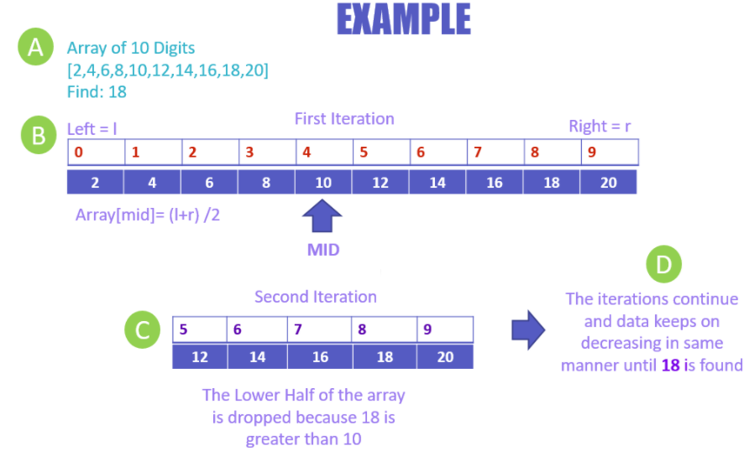
// Check if x is present at mid
if (arr[m] == x)
return m;
// If x greater, ignore left half
if (arr[m] < x)
l = m + 1;
// If x is smaller, ignore right half
else
r = m - 1;
What is the time Complexity of the below example?
l
r

Slide 12
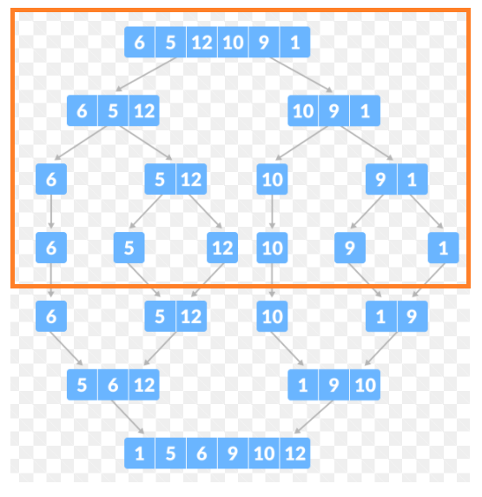
time complexity:O(N log n)
If we want to perform log n operation for every element(i.e: n ) in an array
O (n log n)

Slide 13
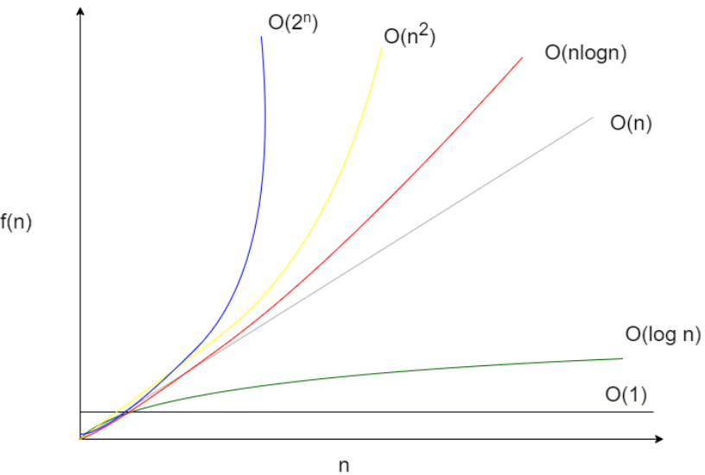
Comparison Graph

Slide 14
Examples
O(1) | O(n) | O(log n) | O (n log n) | O(n^2)
Accessing Array Index int a = ARR[5]; | Linear Search | Binary Search | Merge Sort | Selection Sort
Inserting a node in Linked List | Comparing two strings | Finding largest/smallest number in a binary search tree | Heap Sort | Bubble Sort
Insertion and Removal from Queue | Traversing an array |  | Quick Sort | Traversing a simple 2D array

Slide 15
Space complexity
Space complexity is the amount of memory used by the algorithm (including the input values to the algorithm) to execute and produce the result
Space Complexity = Auxiliary Space + Input space
Auxiliary Space is the extra space or the temporary space used by the algorithm during it's execution
Examples:
int x = 0; // 4 bytes for x
for(int i = 0; i < n; i++) // 4 bytes for i
{
x = x + a[i];
}
int z = a + b + c;
return(z);
O(1)
O(n²)

Slide 16
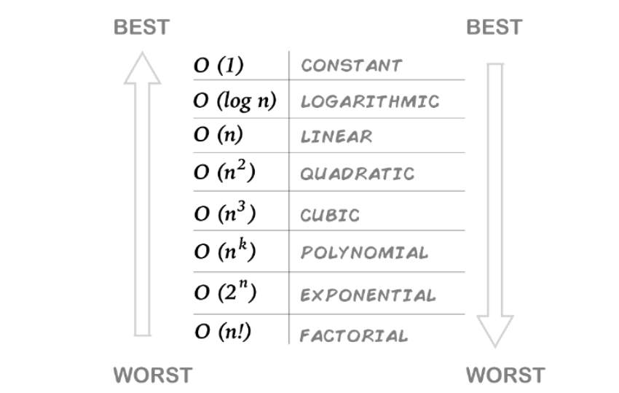
Time Complexity

Slide 17
What is the Time/Space Complexity ?
int a = 0, b = 0;
for (i = 0; i < N; i++) {
a = a + rand();
}
for (j = 0; j < M; j++) {
b = b + rand();
}
Options:
O(N * M) time, O(1) space
O(N + M) time, O(N + M) space
O(N + M) time, O(1) space
O(N * M) time, O(N + M) space

Slide 18
Explanation:
The first loop is O(N) and the second loop is O(M).
Since we don’t know which is bigger, we say this is O(N + M). This can also be written as O(max(N, M)).
Since there is no additional space being utilized, the space complexity is constant / O(1)

Slide 19


Tree and Stone Problem
Write a Program to find the maximal sequence of consecutive stone’s from the above collection

Slide 20





Game
GROUP
Find the no of children’s of same age from the given group
Age 3
Age 5
Age 3
Age 2
Age 4
Age 0 | Age 1 | Age 2 | Age 3 | Age 4 | Age 5
0 | 0 | 1 | 2 | 1 | 1

Slide 21
Counting Elements
Array
3 | 5 | 3 | 2 | 4
Index
0 | 1 | 2 | 3 | 4 | 5
Occurrence
Of each Element
0 | 0 | 1 | 2 | 1 | 1

Slide 22


Game
GROUP 1
GROUP 2
Find the no of children’s of same age from the given group
Age 5
Age 3
Age 3
Age 2
Age 4
Age 0 | Age 1 | Age 2 | Age 3 | Age 4 | Age 5
0 | 0 | 1 | 2 | 1 | 1
22

